Slide 1
Consumer Credit Data: Analysis and Income Prediction
Marshall Yi
March 2017

Slide 2
Overview
Size of data: 275,594 rows x 750 columns
206,695,500 elements
91,039,023 missing, or 44.05%
No complete cases

Slide 3
Imputation Methods Tried in R
Tried the following mice imputation methods:
norm (Bayesian linear regression (numeric))
norm.nob (linear regression ignoring model error (numeric))
2lonly.norm (imputation at level-2 by Bayesian linear regression (numeric))
rf (random forest)
cart (Classification and regression trees(any))
Only cart was able to produce any values, but crashed after several hours running on a google cloud machine with 8 cores & 50 GB RAM
Also tried multiple algorithms for prediction with similar results

Slide 4
Data Analysis
Examined the missingness of the 750 variables
Found that 15 were a categorical code of transactions (“TTRRRIRR”), which are Bankcard Revolver|Transactor|Inactive indicators for months 24 months for the 1st – 5th highest balances
These were removed to be studied at a later date

Slide 5
Data Analysis: Missingness
Performed further examination of the data using VIM::aggr
This showed large areas of missingness
Upon investigation, these included
Mortgages
Home equity loans
Auto loans
Student loans
Credit Union trades
Premium credit card data
These were deemed Missing Not At Random and NAs were zeroed out

Slide 6
Data Analysis: Missingness (cont’d)
Other features with high missingness were untouched. These included data on:
Foreclosures
Repossessions
Bankruptcies
The thinking is that these would be bad data points to zero out as they are better to be undetermined rather than zero as credit quality is an important theme
Credit card data was also untouched as this was deemed Missing At Random

Slide 7
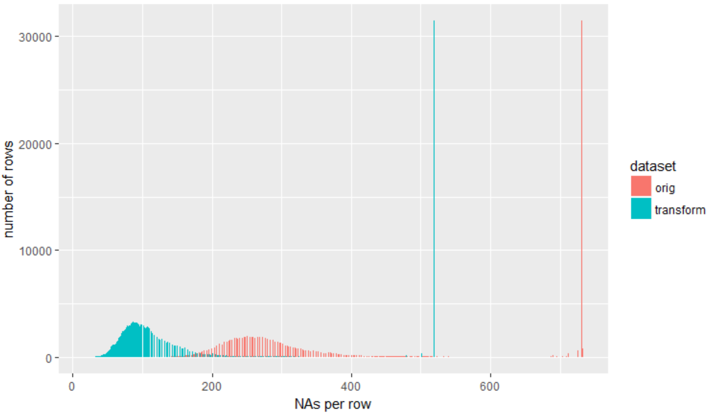
Data Analysis: Missingness (cont’d)
213 features with NAs zeroed out after looking at the data

Slide 8
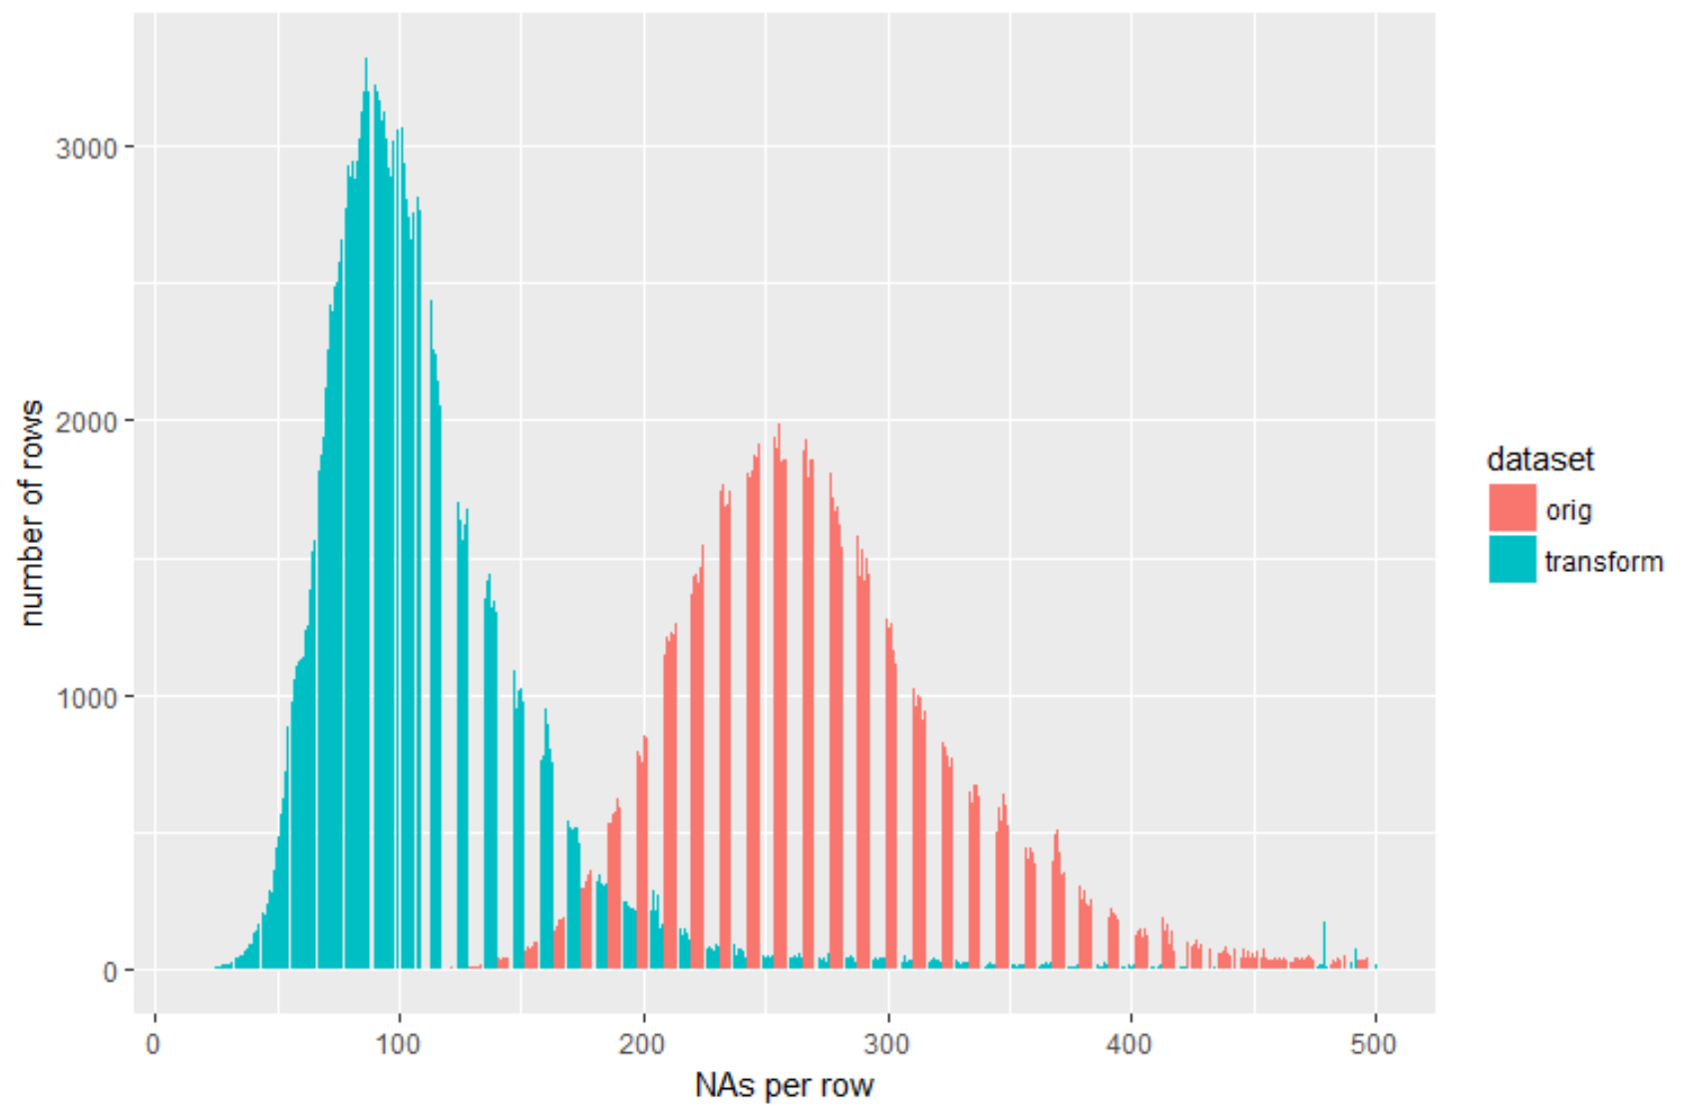
Data Analysis: Missingness (cont’d)
Distribution of NAs per row without extreme counts

Slide 9
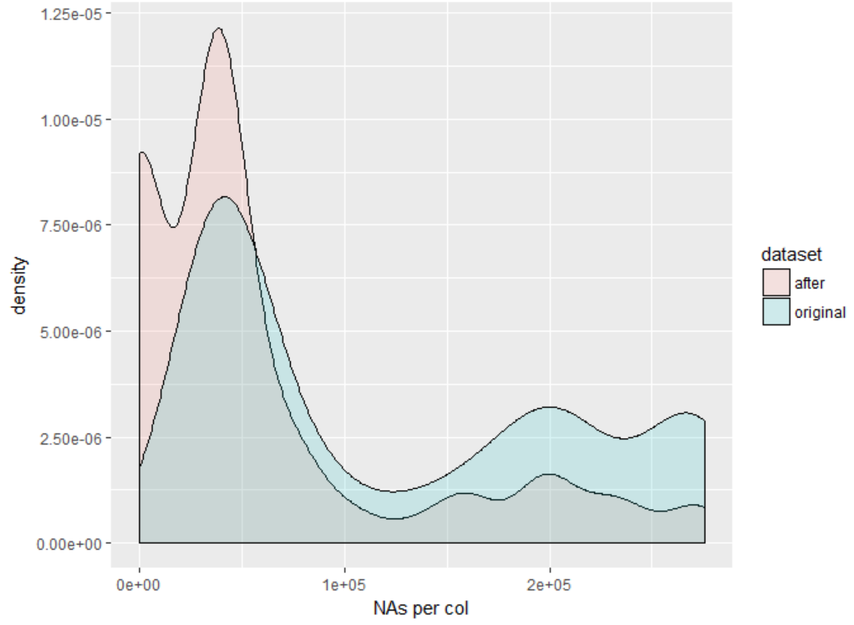
Data Analysis: Missingness (cont’d)
Density plot of column missingness

Slide 10
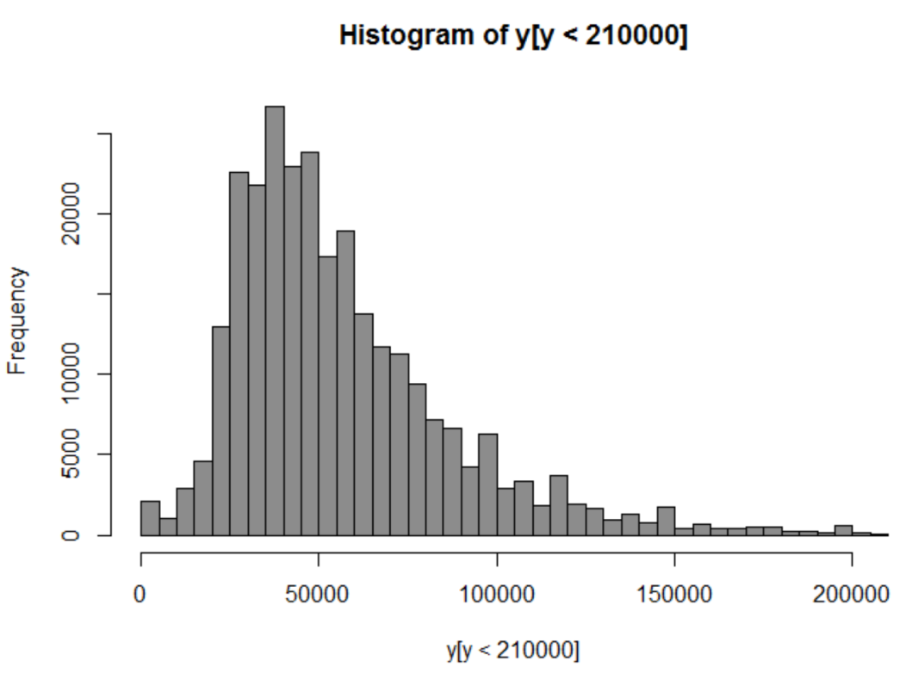
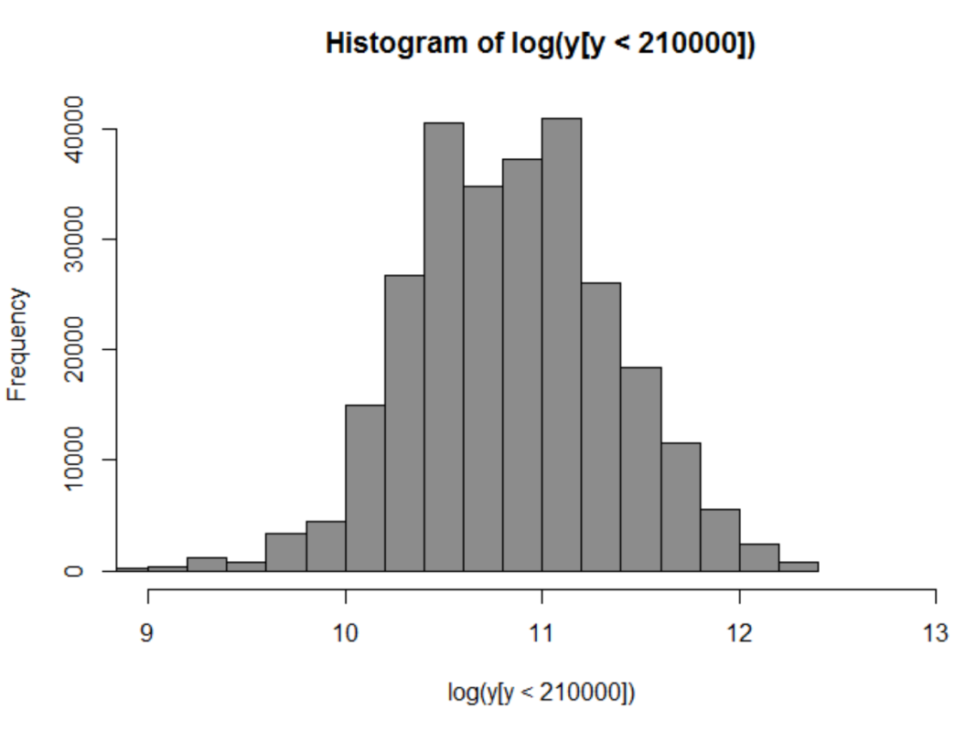
Analysis of Income
Goal is to predict Income with a preference for lower predictions.

Slide 11
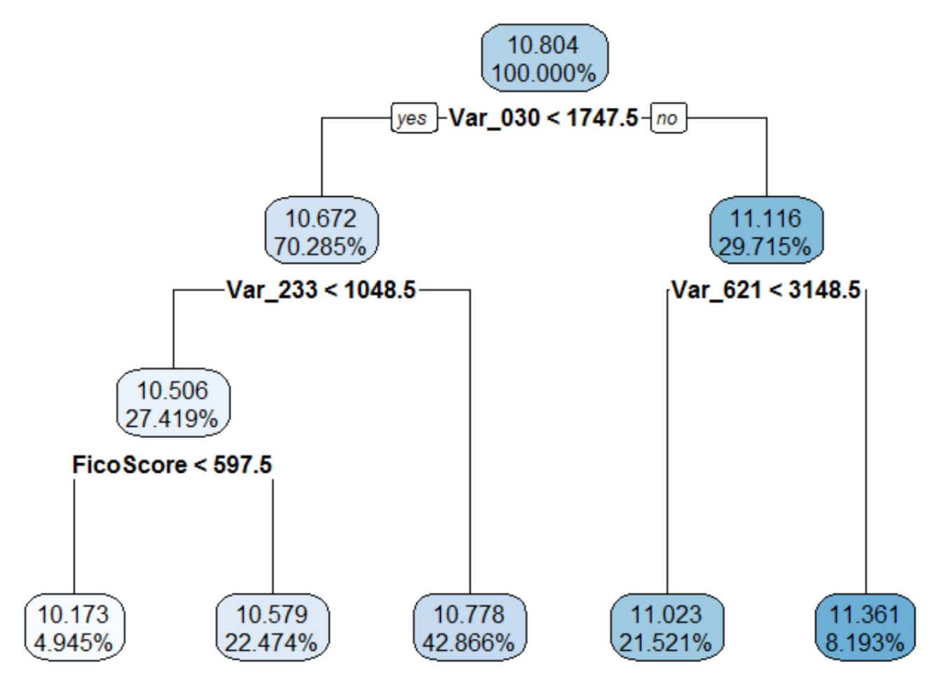
CART
Variable | Importance | Description
Var_030 | 19.4% | Total scheduled monthly payment for all trades verified in past 12 months
Var_621 | 17.0% | Total monthly obligation of trades verified in past 3 months
Var_233 | 12.1% | Total monthly obligation for all accounts
FicoScore | 7.6% | FicoScore
Root node error = 43.68% Incomes: {$26,187; $39,301; $47,954, $61,267; $85,905}

Slide 12
CART Summary
Approximately 92% make under $86,905
The data shows that the bulk of the individuals make between $39,301 - $61,267
These are realistic figures and should not overestimate the income of applicants

Slide 13
XGBoost
Rounds 300
Max Depth 3
Training RMSE 0.611
Test RMSE 0.628

Slide 14
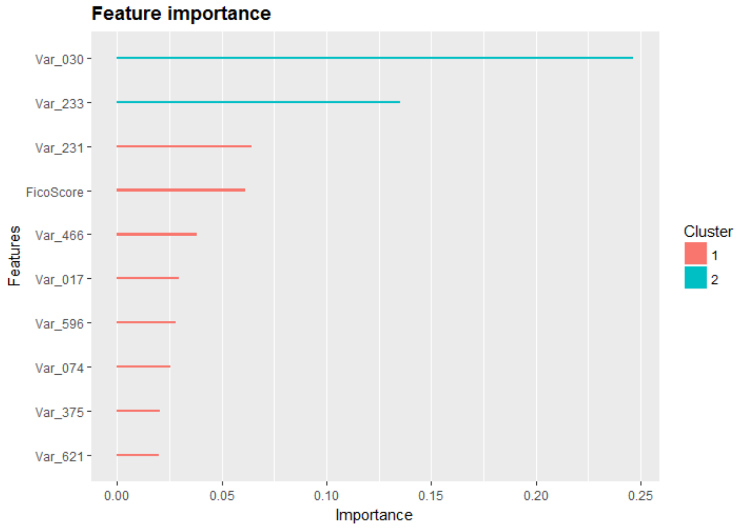
XGBoost
Variable | Description
Var_030 | Total scheduled monthly payment for all trades verified in past 12 months
Var_233 | Total monthly obligation for all accounts
FicoScore | FicoScore
Var_231 | Total monthly obligation for individual account verified in past 12 months
Var_466 | Number of premium credit card trades
Var_017 | Total credit line of open trades verified in past 12 months (excluding mortgage and home equity)
Var_596 | Aggregate Monthly Spend over last 12 Months
Var_074 | Total credit line of open credit card trades verified in past 12 months
Var_375 | Total scheduled monthly payment for open installment trades verified in past 12 months
Var_621 | Total monthly obligation of trades verified in past 3 months

Slide 15
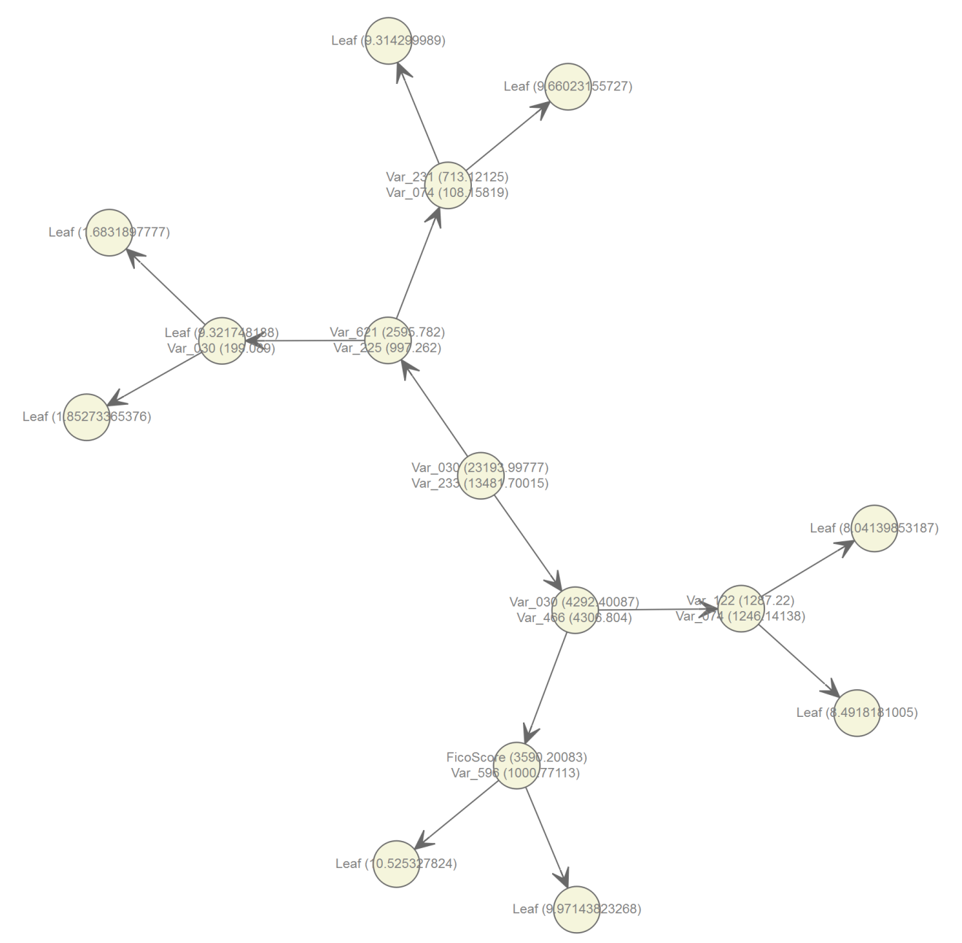
XGBoost Tree

Slide 16
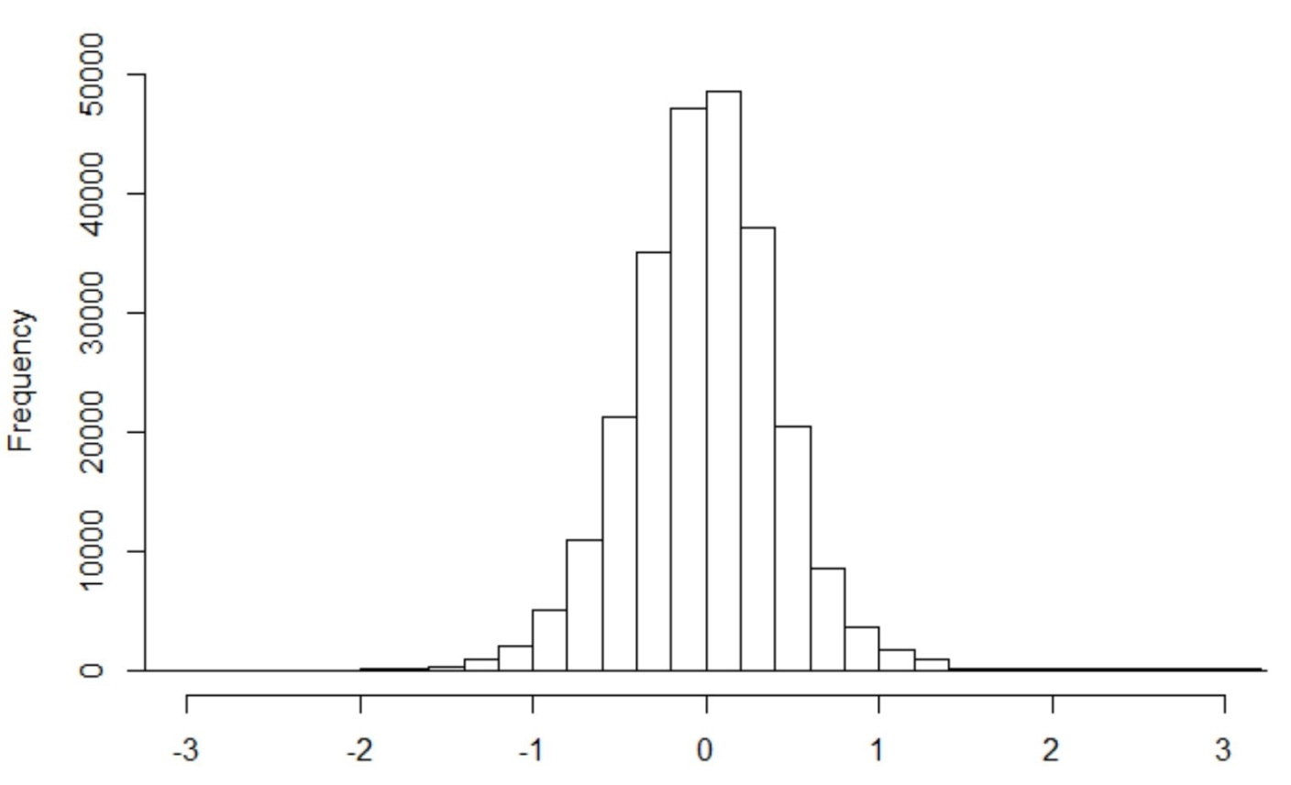
XGBoost Residuals

Slide 17
Summary
CART model is easier to understand
XGBoost residuals too large for prediction, i.e. a +/- 0.5 off the mean spans $31k - $84k
To Do: Try to incorporate the categorical data

